Slide 1
ARIZONA
STATEWIDE POLL
ON HEALTH CARE QUALITY, ACCESS AND AFFORDABILITY
Key Findings
AUGUST 2021

Slide 2
Survey Methodology
ALG Research conducted an online survey of registered voters in Arizona.
Interviews for this survey were conducted July 16-21, 2021.
The survey consisted of N=602 total respondents. Overall results were weighted to reflect the composition of registered voters across the country.

Slide 3
Key Findings
Arizonans’ biggest problem with health care: it’s too expensive.
Voters agree health care costs continue to rise creating an environment where even those with insurance aren’t sure what their costs will be and struggle to pay their bills. The result – nearly three-tenths of all Arizona voters, including more than half of those struggling financially, have unpaid or overdue medical bills.
Voters want elected officials to get those costs down, but not at the expense of their access to quality care.
Voters are especially concerned about out-of-pocket costs like high deductibles, surprise bills, and high premiums.
They believe having “good” health care also means have access to quality providers.
Voters don’t want dramatic changes while the health care system is stressed from COVID-19.
Very few are clamoring for a fully government-run health care system, and 69% of voters agree we should be cautious about making changes to the health care system while it is still stressed coming out COVID-19. Instead, most believe we should build on the system we have through targeted fixes.

Slide 4
THE CURRENT STATE OF HEALTH CARE

Slide 5
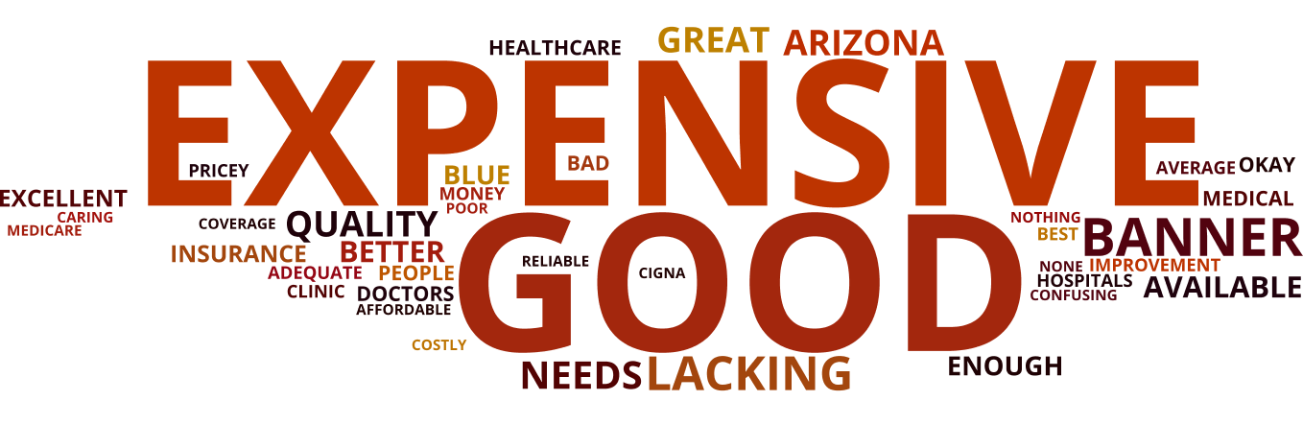
While voters believe the health care system in Arizona is “good,” “expensive” is the word that dominates their associations with it.
What is the first word or phrase that comes to mind when you think of health care in Arizona? [OPEN END]

Slide 6
Rising costs and unaffordable bills are both burdens.
Those with private health insurance are significantly more affected by rising costs than those with public health insurance.
Do you agree or disagree with the following statements?
The amount I pay for health care seems to be going up every year. | At some point in my life I have struggled to pay a medical bill, even while I had health insurance.
+66 | +16
+76 | +23
Overall Net Agree
Private Insurance Net Agree

Slide 7
More than half of voters are concerned about health care-related expenses.
What they’re most worried about: high deductibles and surprise medical bills.

Slide 8
Nearly three-tenths of all voters have unpaid or overdue medical bills, including nearly four-tenths of Hispanic voters.
Among those struggling financially, a majority have unpaid or overdue medical bills.
Do you currently have any unpaid or overdue bills from a medical service provider, hospital, lab, or other health care service that you are finding difficult to pay off?
OVERALL
HISPANIC
STRUGGLING FINANCIALLY

Slide 9
SOLUTIONS

Slide 10
Voters are looking to Congress for targeted fixes that build on the current system, not to fundamentally transform it.
Even among Democrats, just 39% would rather fundamentally transform our system.
Thinking about changes Congress could make to the health care system, which is closer to your view?
Congress should focus more on building upon the current system by making specific fixes, such as reducing out-of-pocket costs | Don't know | Congress should focus more on fundamentally transforming the health care system
NET BUILD
+28
+16
+23
+43

Slide 11
Voters want elected officials to get costs down.
When it comes to health care, what would you like to see worked on most in Arizona?

Slide 12
Legislation that aligns with their priorities would lower deductibles and prevent insurance companies from selling junk plans.
These are politically durable solutions with high support across party lines.
Do you agree or disagree with the following statements?
Insurance deductibles should be low enough that they don’t get in the way of getting the health care you need. | Insurance companies should not be allowed to sell plans that cover so little that going to the doctor isn't affordable.
+86 | +76
+89 | +79
+88 | +73
+83 | +76
Overall Net Agree
Democrat Net Agree
Independent Net Agree
Republican Net Agree

Slide 13
Arizonans overwhelmingly support the introduction of pricing transparency, caps for prescription costs, and restricting predatory medical debt collections.
A public option has net support, but less than other policy options presented.
NET
+84
+69
+66
+48
+44
+37
Create pricing transparency so that consumers can compare pricing for services and create competition between providers
Place an annual cap on out-of-pocket drug costs for consumers
Restricting hospitals usage of predatory debt collection practices for outstanding medical bills
Provide tax credits to reduce premiums for families who purchase insurance through the individual market
Create a so-called public health insurance option, which is a health plan run by the government that would compete with private health insurance plans, and small business would be able to buy affordable health insurance for their employees through it
Create a so-called public health insurance option, which is a health plan run by the government that would compete with private health insurance plans and be available to all Americans regardless of age

Slide 14
Arizonans, especially those personally affected by the virus, are concerned about the cost and coverage impacts for COVID-19 survivors.
This concern also extends to a majority of voters across party lines.
How concerned are you that Arizona residents who became infected with COVID 19, became seriously ill but survived, then developed serious health problems, may have to pay a greater share of their health care cost or not be covered at all because they contracted COVID?

